Slide 1
MEG and Structural Change
EBH26, LECTURE 3

Slide 2
PLAN
Innovation and Growth
'Industrial Revolution'?

Slide 3

1. ‘Industry’ and ‘Industrial Revolution’
?

Slide 4
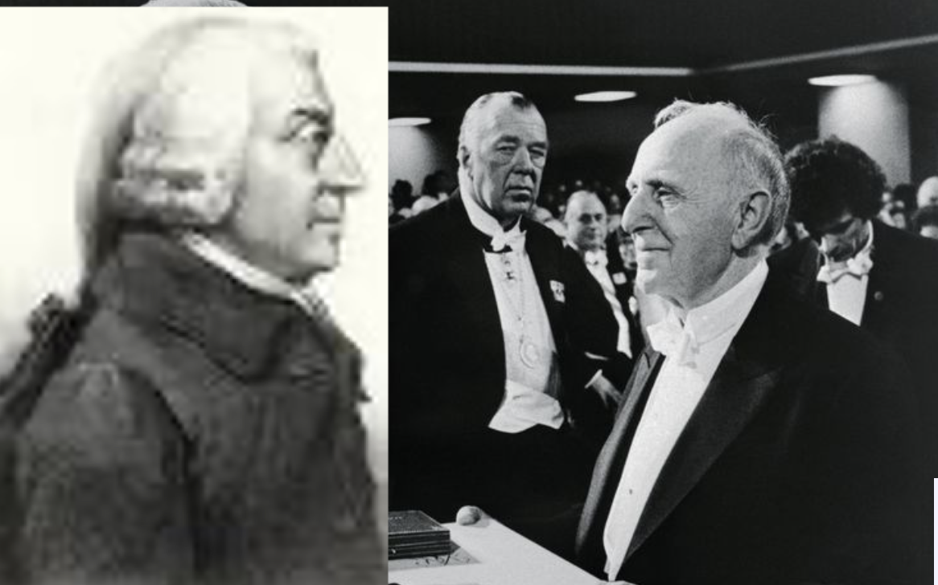
Smith vs Kuznets

Slide 5
Industrial Revolution: theory or period?
The term “Industrial Revolution” (IndRev) describes 3 distinct ideas
a period (very loosely, 1750-1850) in which growth accelerated (this is the usage given by Galor)
a process (approx. the same as ‘MEG’)
a theory for explaining growth, arguing that growth comes from technological and structural change originating in the industrial sector
In 1 and 2, IndRev is a conventional term (like the 'Middle Ages', the 'Rennaissance', 'Climate Crisis', 'Cold War') or a well-defined process, with quantitative features
Meaning 3 is unsustainable, for reasons exposed here.

Slide 6
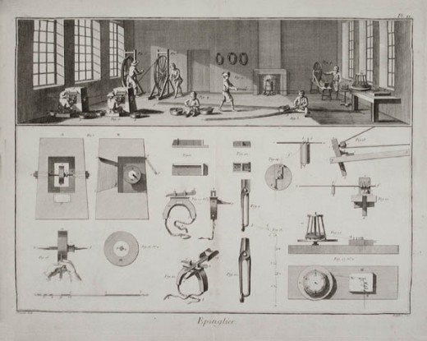
Growth in Labour Productivity
Economic growth implies the increase of output per worker (or hour worked)
The increase in labour productivity is typically the result of more (physical or human) capital per worker, like in Adam Smith's Pin Factory
By contrast, in the IndRev theory, economic growth was an effect of rapidly-improving technology (steam machines and labour-saving machinery in textile industry and ironworks) in 1700-1800. Does this make sense?
A 18th-cent. pin factory, Adam Smith’s example of how the division of labour multiplied productivity by a very large factor … in the industrial sector

Slide 7
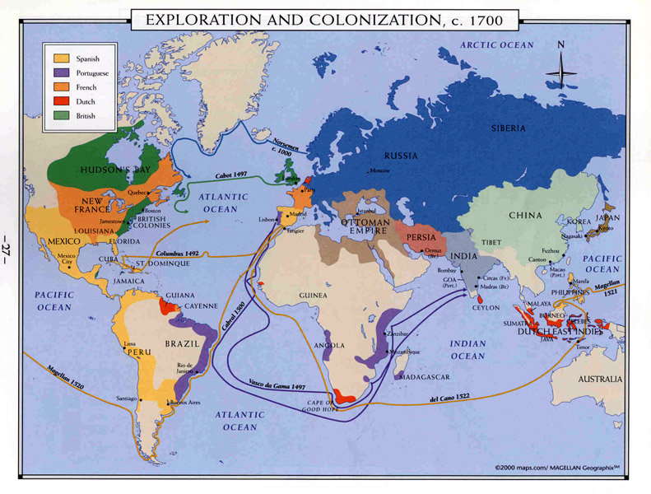
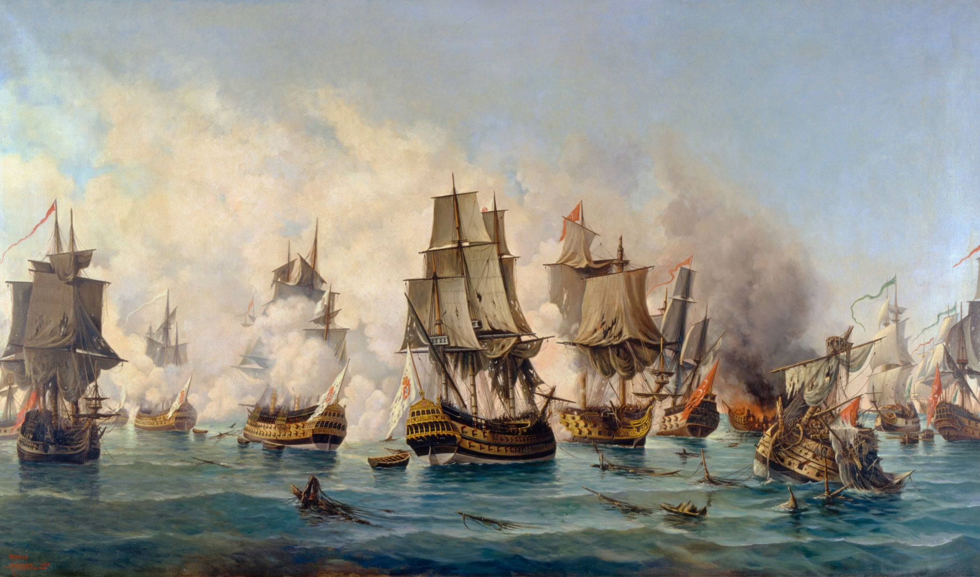
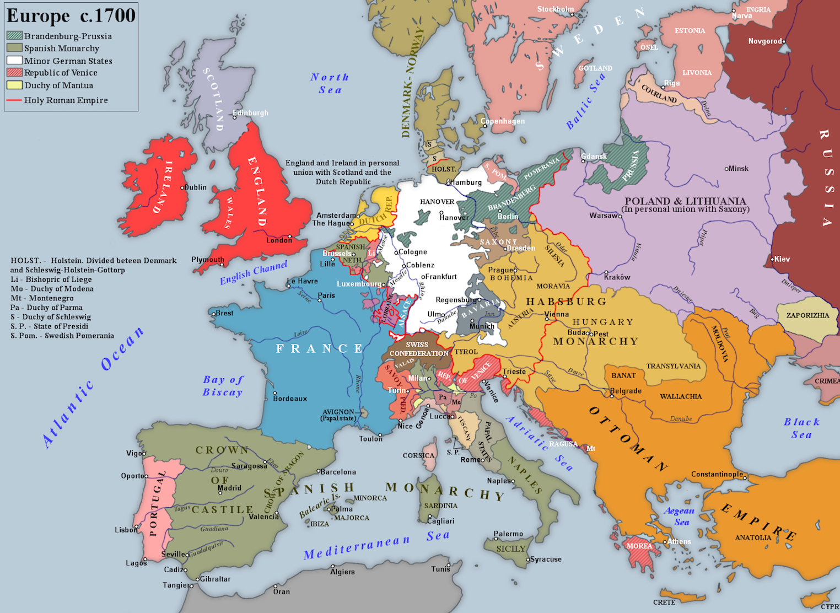
Why an 'IndRev' could not occurr with changes in the industrial sector?
In a market economy, prices and wages in the agrarian sector would rise abruptly in case of a massive flow of labour and capital into the industrial sector.
18th-cent Europe did not have the technological conditions to transport bulk agrarian goods across borders
Given proteccionism and great powers’ frequent warfae, the political conditions for smooth trade were also lacking

Slide 8
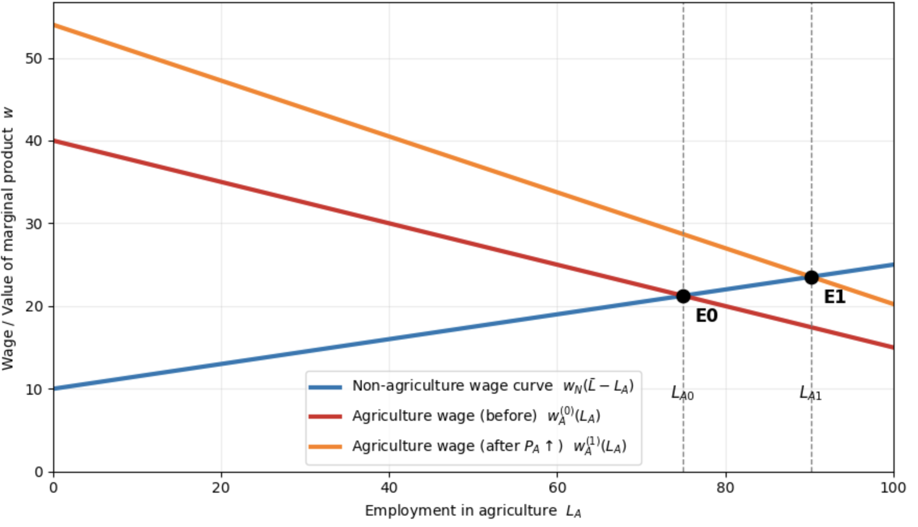
Why an 'IndRev' could not occurr etc.? (2)
Given proteccionism and great powers’ frequent warfae, the political conditions for smooth trade were also lacking
As such, each country was constrained by its natural resources
This problema can be called ‘The Agrarian Deadlock’ and is coherent to the Malthusian theory:
Natural scarcity prevents any sustainable rise in incomes

Slide 9
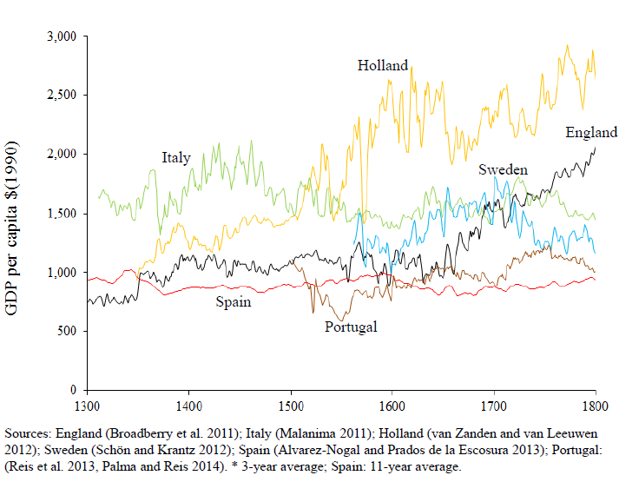
MEG. When and Where?
How was the Agrarian Deadlock broken here?

Slide 10
Agricultural Population (%)
 | 1705 | 1775 | 1845
England | 35 | 29 | 20
France | 70 | 65 | 59
Prússia | 80 | 70 | 60
Spain | 71 | 66 | 61
Average | 64 | 58 | 50
Source: Dennison e Simpson 2010: 149

Slide 11
The Agrarian Deadlock
By 1700, England was already well ahead of its continental rivals, as it was able to provide its essential goods with a small share of the population (reminder: by the 18th century, no tech or political conditions for trading bulk agrarian goods across borders)
Also, England was more urbanised, wages were higher and specialization was more advanced

Slide 12
English Headstart in Agriculture
Agr. Product.
Urbanization
Specialization
High wages
English and Dutch farm sector had more stimuli to increase productivity
High wages, higher productivity in other sectors, urbanization and specialization both stimulate and increase higher agrarian productivity
Yet, all these variables (industrial productivity, high wages, specialization and urbanization) are closely intertwined and have reciprocal causality
Can we find some independent variables?

